Slide 1
Chapter 7
Evaluating Educational Technology and Integration Strategies

Slide 2
Chapter Objectives
Identify sources of information for evaluating educational technology and digital media
Outline the considerations and tools used to evaluate software applications, including apps
Describe and explain the key criteria used to evaluate Web resources
Describe the tools for evaluating the effectiveness of technology
Compare and analyze the methods used to evaluate student projects

Slide 3
Chapter Objectives
Identify different technology integration strategies by classroom layout and design
Define and describe the value of a curriculum resource page
Describe ways to integrate technology into specific curriculum subject areas
Describe authentic assessment tools for student projects
Identify and compare possible sources of funding for classroom technology

Slide 4
Evaluating Educational Technology
Evaluating the appropriateness and effectiveness of educational technology is an important aspect of integrating current technologies into your classroom curriculum
Evaluate before, during, and after instruction

Slide 5
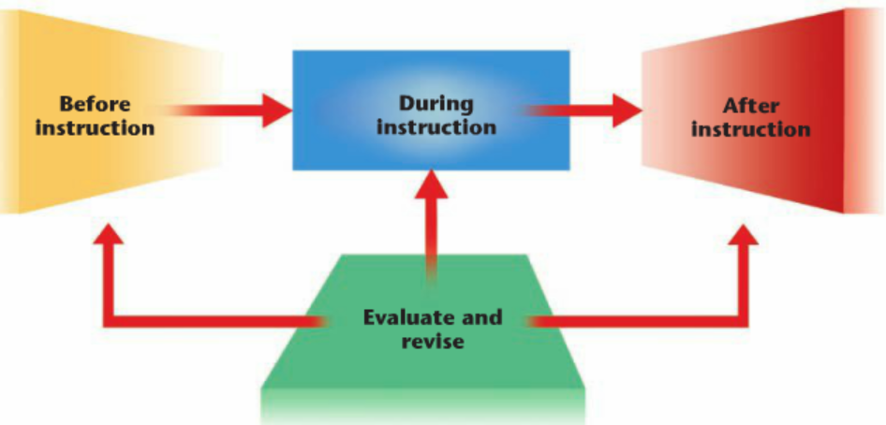
Evaluating Educational Technology

Slide 6
Evaluating Educational Technology
Sources of Information
  Numerous resources and technologies to choose from
School districts and state Departments of Education
  Lists of recommended software, including apps
Professional educational organizations
  Local, state, regional, national, and international educational organizations
  Web sites for organizations

Slide 7
Evaluating Educational Technology
Apps Reviews
  Evaluated by users and reviews are listed with other information about the app
    Often includes integration ideas
Colleague Recommendations
  Discuss issues with other educators
  Often based on firsthand experience
Published evaluations
  See company’s Web site
  Educational journals
Conferences
  National and state organizations
  Presentations
  Meet representative from hardware and software companies

Slide 8
Evaluating Educational Technology
The Web
  Mailing lists
    EDTECH
  Forums
  Newsgroups
  Discussion groups
  Listservs
  Wikis
  Blogs
  Webinars

Slide 9
Evaluating Educational Technology
Evaluating Software Programs
  Free trial versions
  Software/app evaluation rubrics
    Page 357 – 358 in book

Slide 10
Evaluating Software Programs Content
Content
  Is the software/app valid?
  Relate content to school’s and state’s specific curriculum standards and related benchmarks
Documentation and technical support
  Documentation
    Printed or online information
  Technical support
    Telephone or Web support
Ability levels and assessment
  Can software or app be used with various ability and academic levels?
  Can software or app adjust the academic level and students move through the skills?

Slide 11
Evaluating Software Programs Content
Technical quality and ease of use
  Technical quality
    How well the software or app presents itself and how well it works
  Ease of use
    User friendliness
  Student opinion is important in these criteria

Slide 12
Evaluating Web Resources
Authority
  Is the author or organization clearly identified?
  Examine the credentials of the author or organization of the Web site
  Has the author or organization listed experience, position, education, or other credentials?
Affiliation
  Who is the Web site associated with?
  Examine the URL and domain name
Purpose and Objectivity
  Is the content provided as a service?
  Is the content unbiased?

Slide 13
Evaluating Web Resources
Content and Learning Process
  Is the content valid and appropriate?
  Does the information relate to your needs?
  What topics are covered?
  For what level is the information written?
  Do the links within the site add value?
Audience and currency
  Is the content suitable for your students?
  Is the content up to date and timely?
Design
  Web effectiveness
  Web evaluation rubric
  Student Web Site Evaluation Rubric
    Page 362 – 363 in book

Slide 14
Assessment Tools for Evaluating the Effectiveness of Technology Integration
Measure student performance
Reliable assessment
  accurately estimate student performance
  permit appropriate generalizations about the students’ skills and
  Abilities
  enable teachers or other decision makers to make appropriate decisions.
Traditional assessment
  Testing

Slide 15
Assessment Tools for Evaluating the Effectiveness of Technology Integration
Alternative assessment
  Authentic assessment (performance based assessment)
  Project-based assessment
  Portfolio assessment
  Checklist
  Rating scale
  Rubric
Teacher observation
  Observe motivation
  Observe how long students work on an objective

Slide 16
Assessment Tools for Evaluating the Effectiveness of Technology IntegrationTechnology-Based Student Projects
Integrated learning systems (ILS)
  Automatically track student progress
Assessment rubric
  Page 366 in book

Slide 17
Evaluating Technology-Based Student Projects
Evaluating content
  Based on your standards and benchmarks
  Review punctuation, grammar, spelling, coverage of material, presentation of the material in a logical order, and specific information about the author
Evaluating planning
  How do you want your students to plan?
  What tools will the students use?
  Software tools (Inspiration)
  Visual learning techniques
  Flowcharts
  Concept map or story web
  Storyboard

Slide 18
Evaluating Technology-Based Student Projects
Evaluating creativity
  Evaluate originality, imaginative and innovative approach, and artistic abilities
  Color, clip art, and artwork should strengthen content

Slide 19
Integration Strategies
Teachers must become facilitators of learning
Use technology to enhance learning environment
Put technology at point of instruction
Many mixtures of technology

Slide 20
Integration Strategies
One-Computer Classroom
  Use the computer for classroom presentations and demonstrations
  Introduce new concepts
  Students use to present assignments, projects, and research activities to the entire class
  Maintain class records, create presentations and projects, do research, and communicate with other teachers
  Obtain Internet access
  Utilize educational software
  Enhance lectures and presentations
  Use the computer as a teaching assistant
  Foster group and cooperative learning

Slide 21
Integration Strategies
One-Computer Classroom
  Write an ongoing story
  Create a class blog
  Start a class newsletter
  Maintain a student database
  Teacher productivity tool
  Optimize computer lab time
  New emerging technologies

Slide 22
Integration Strategies
Multicomputer Classroom
  Multiple learning centers
  Integrate other technologies
    Digital camera
    Web research centers
    Develop presentations

Slide 23
Integration Strategies
Computer Labs/Media Centers
  All students have hands-on experience
  Often used to teach technology skills or subject-specific skills
  Integrate computer-related skills into subject-directed curriculum areas
  Example: Web scavenger hunt

Slide 24
Curriculum Integration Activities
Curriculum Resource Pages
  Strategy for implementing the Internet into the classroom
  Teacher-created document containing hyperlinks to teacher-selected Web sites that assist in teaching content-specific curriculum objectives
Interactive Lessons and Assessment
  A learner response system is made up of IWB software that is installed on a teacher’s computer, a wireless receiver, and student hand-held infrared transmitters that collect student responses or data in real time
Creating Lesson and Project Plans
  Must integrate technology into lesson plans and activities
  Educator’s Reference Desk
  Lesson plans and activities can be found on the Web

Slide 25
Finding Funds to Support Classroom Technology Integration
Many school districts do not have sufficient funding for technology
If school cannot provide funds, turn to the public, industry, and the government
Fund-raising Drives and Contests
  Partner with local businesses
  Small amounts of money can go a long way
  Enter contests to win equipment
  Involve parents and community
    Showcase students’ use of technology
  Volunteers

Slide 26
Finding Funds to Support Classroom Technology Integration
Grants
  Funds provided by a funding source that transfers money, equipment, or services to the grantee
  Grantee is the teacher, school, or organization
  Sources: Department of Education, federal sources, foundations, and corporations
  Request for proposal (RFP)
  Grant proposal
  Look for opportunities on the Web

